Slide 1
Gen Z Career Aspirations: Business Analysis By Kulturehire
JAYASREE S

Slide 2
ROADMAP
1
3
5
7
Dashboards
Data Collection
Analyzing in SQL
Focused PowerBI dashboard
Developed three dashboards on customer service, finance and orders in EXCEL
Created a Google Form with tailored questions to collect data on Gen-Z's career aspirations.
Conducted data analysis using SQL, solving complex questions with the help of Common Table Expressions (CTEs) and joins.
Developed three focused dashboards for each area, incorporating KPIs, Power Query Editor, measures, and groups in Power BI.
2
4
6
8
Problem Statement
Cleaning in SQL
General PowerBI dashboard
Presentation
Developed a problem statement to explore and educate about the career aspirations of Gen-Z, addressing challenges and personal insights.
Loaded data dump into MySQL Workbench, cleaning and exploring high-level information using SQL basics.
Created a Power BI dashboard summarizing Gen-Z's learning aspirations, mission aspirations, and manager aspirations.
Worked on an employer-focused project, creating recommendations and emphasizing the importance of storytelling in data.

Slide 3
STAGE 1:PROBLEM STATEMENT
GenZ individuals often struggle to communicate their ambitions and preferences effectively to employers, resulting in a disconnect between their aspirations and the roles offered. Simultaneously, employers find it challenging to attract and retain GenZ talent. Misalignment in expectations regarding workplace culture, benefits, and career development creates barriers for both parties.

Slide 4
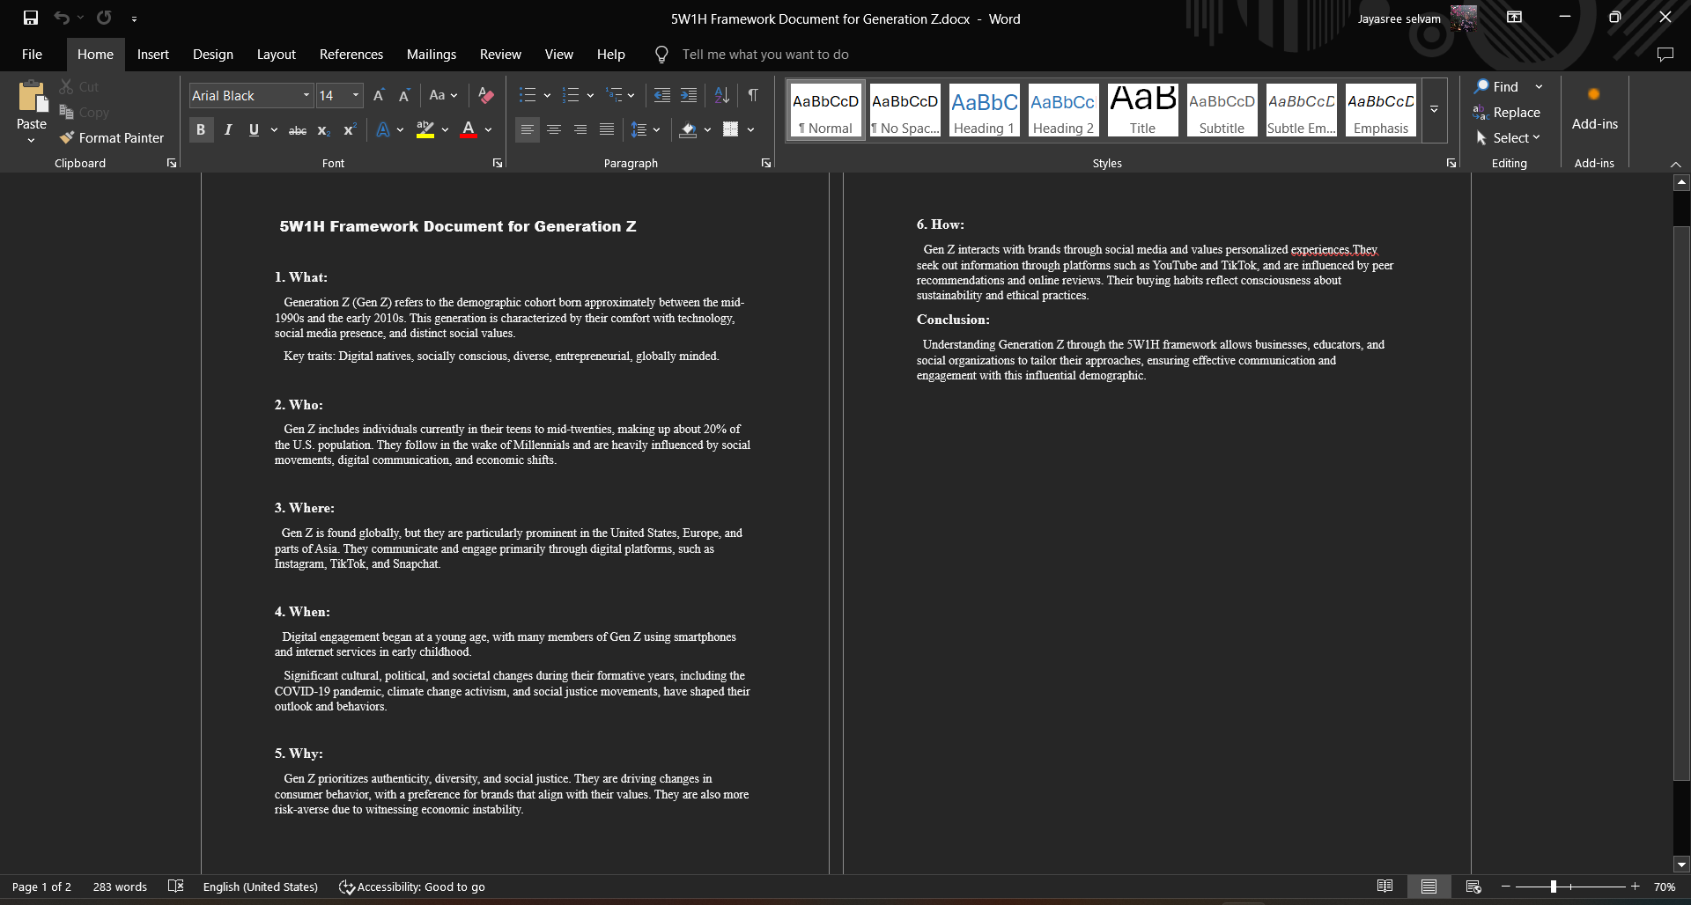
STAGE 2:PROBLEM DOCUMENTATION USING 5W1H FRAMEWORK

Slide 5
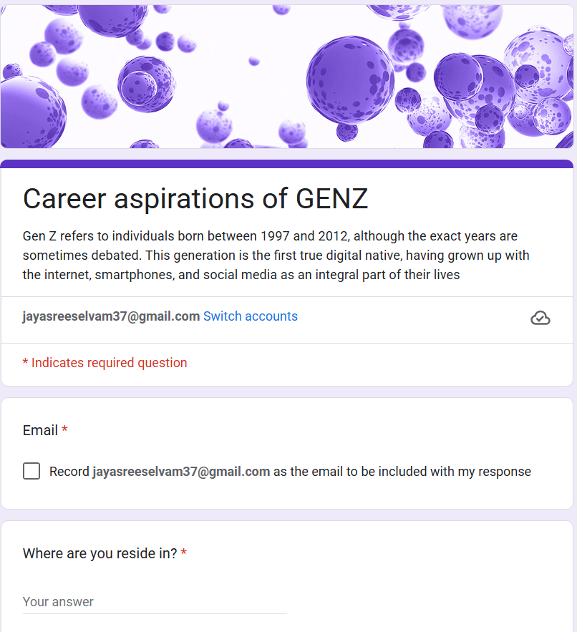
STAGE 3:DATA COLLECTION

Slide 6
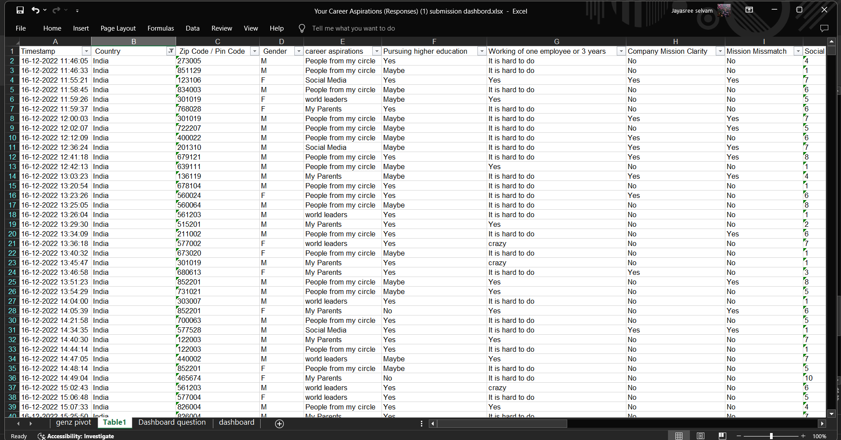
STAGE 4:DATA STANDARDIZATION AND CLEANING

Slide 7
STAGE 5:GENZ USING PIVOT TABLE
QUESTIONS:
What are the top 5 influences on career aspirations?
Top 5 preferred company types.
GenZ who wanted to pursue a Higher Education
Top 3 work setup
Alignment of company mission and actions
Clarity of company mission (percentage).
Distribution of minimum expected salary for the first three years.
Most common work frustrations.
Slicer as Gender
KPI - Total Respondents
KPI - Gender Distribution (Eg: 60% Male, 40% Female)

Slide 8
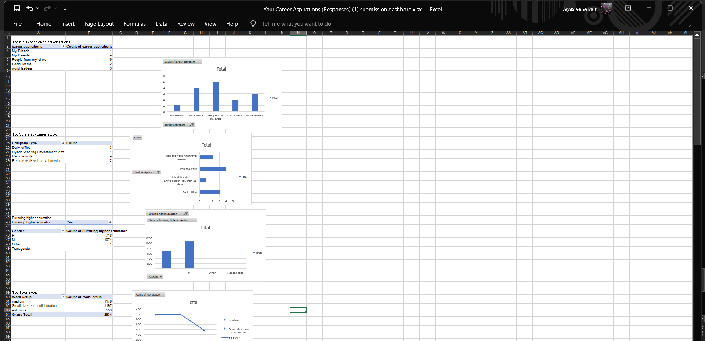

Slide 9
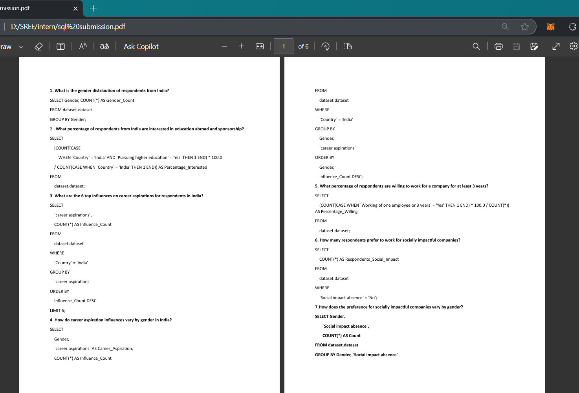
STAGE 6:SQL

Slide 10
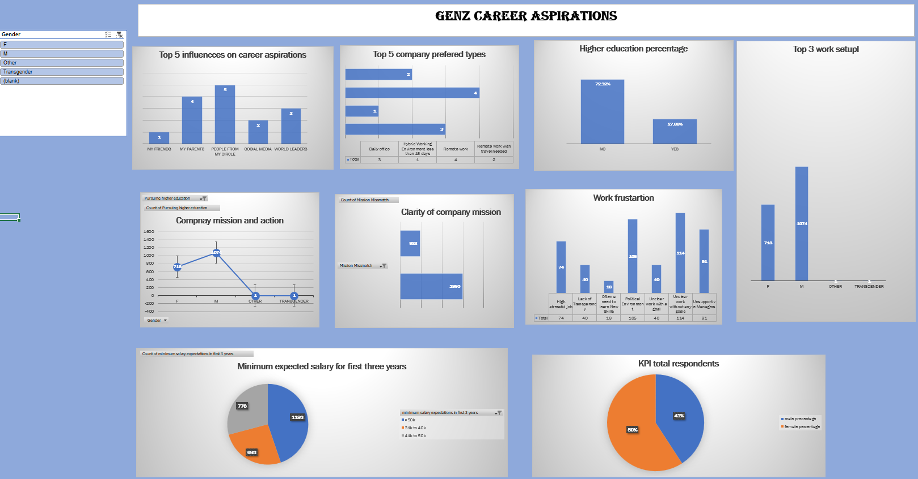
STAGE 7:EXCEL DASHBOARD

Slide 11
STAGE 8:POWERBI DASHBOARD

Slide 12


Microsoft Power BI

Slide 13
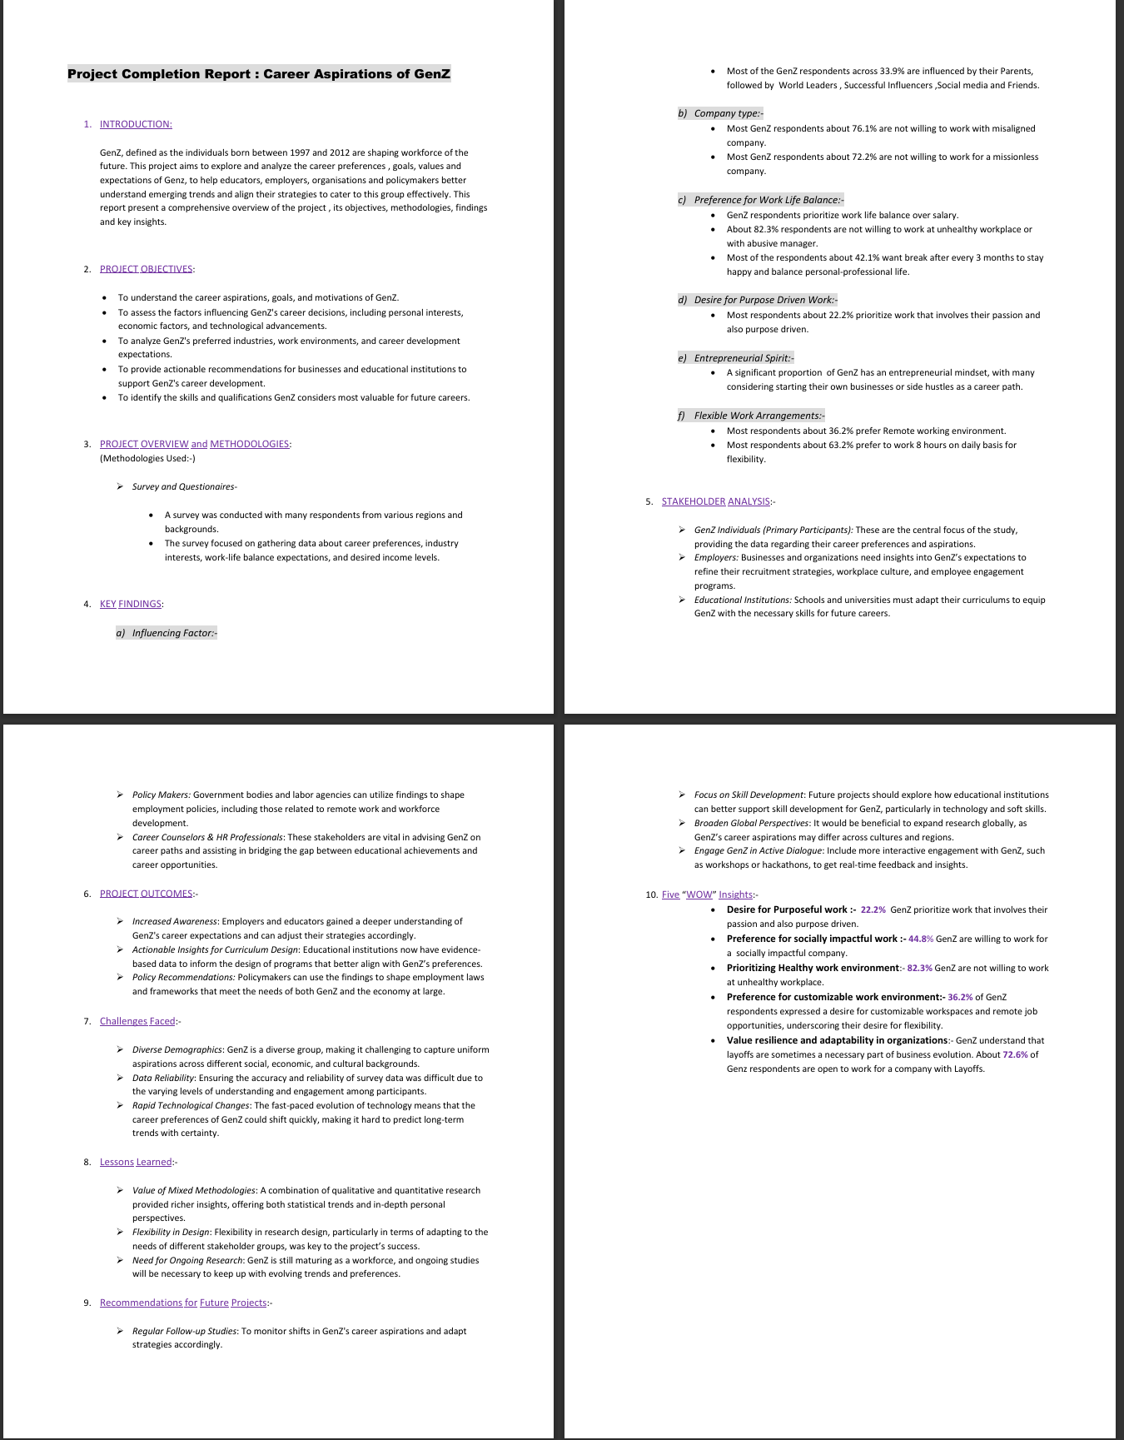
STAGE 9:PROJECT COMPLETION REPORT

Slide 14
THANK YOU

